Slide 1
Annual Report 2018 -2019

Slide 2
- Mother Teresa
“I alone cannot change the world, but I can cast a stone across the waters to create many ripples.”

Slide 3
Walk through
Our Founder & Managing Director
Vision
Mission
Objectives
Trustees
Organizational Structure
Our Social Initiatives/Programmes
Awards & Recognitions

Slide 4
Our Founder & Managing Director
MANITHAM is a SOCIAL WORK ORGANIZATION & TRUST located at Trichy.
MANITHAM SOCIAL WORK ORGANIZATION & TRUST was started on 1st JUNE 2012 & Registered on 3rd JUNE 2018 by Mr. R. Dinesh Kumar B.C.A., M.S.W., PGDC.
This MANITHAM SOCIAL WORK ORGANIZATION & TRUST was started with a Nobel cause and social commitment to lend a helping hand to the needy & afflicted, cater to the needs of the aged & sick people, provide Good and quality education to the community children.

Slide 5
VISION
Save Humanity, to create an immaculate society

Slide 6
MISSION
To promote the importance of aged people’s care amidst the younger generations and help the homeless & abandoned aged people.
To provide quality of Education, Health and Food for the Orphan children.
To Support for Women Empowerment and Youth Career Growth
To support for socially and economically backward community.
To promote agriculture among youth.
To save and promote the importance of Environment and Natural Resources preservations.

Slide 7
Objectives :
To establish and develop programs for the poor people and to provide them self-employment, education, food, clothing or provide other necessary help with regards to basic amenities.
To help poor people in all possible ways in order to make them self reliant and self-supportive.
To start up activities to encourage and develop socio-economic standards of women, children, orphans, semi orphans, poor and marginalized groups.
To help women and children in all possible ways in order to make them self-reliant and self-supportive.
To prevent exploitation of children and to enforce the rights of the children and also to work towards abolition of child labor.

Slide 8
TRUSTEES
FOUNDER & MANAGING DIRECTOR
Mr. R. Dinesh Kumar
SECRETARY
C. Mohan Doss
TREASURER
J. Upendran

Slide 9
Organizational Structure
FOUNDER &
MANAGING DIRECTOR
SECRETARY
ADMIN/ACCOUNTS
SOCIAL WORKERS
TREASURER
NURSING STAFF/CARETAKER
FIELD WORKERS
ASSISTANT CARETAKER
EVENING TUTION TEACHER
COOK
TAILORING TEACHER
HOME MAID

Slide 10
OUR SOCIAL INITIATIVES/PROGRAMES
KANAVU PADIKATTU THITTAM
MEETHAM PAGIRVOM
PUTHUMAI PENGAL
URAVODU INAIPOM
PASUMAI DESAM
ARASIYAL PALAGU
SPECIAL PROGRAMME AND CELEBRATIONS
YOUTH LEADERSHIP TRAININGS

Slide 11
Manitham Schemes with Logo

Slide 12
KANAVU PADIKATTU THITTAM
“Intelligence plus character – that is the goal of true education.” – K Kamarajar.
AIM :
Our KANAVU PADIKATTU THITTAM focuses on rendering quality education, nutritious food and providing good health care for Orphan & semi orphan children.
EXECUTION :
We execute this scheme by providing a piggy bank to the kids of our contributors and donors thereby inculcating the practice of saving which in turn instills the feeling of social responsibilities and commitment.

Slide 13
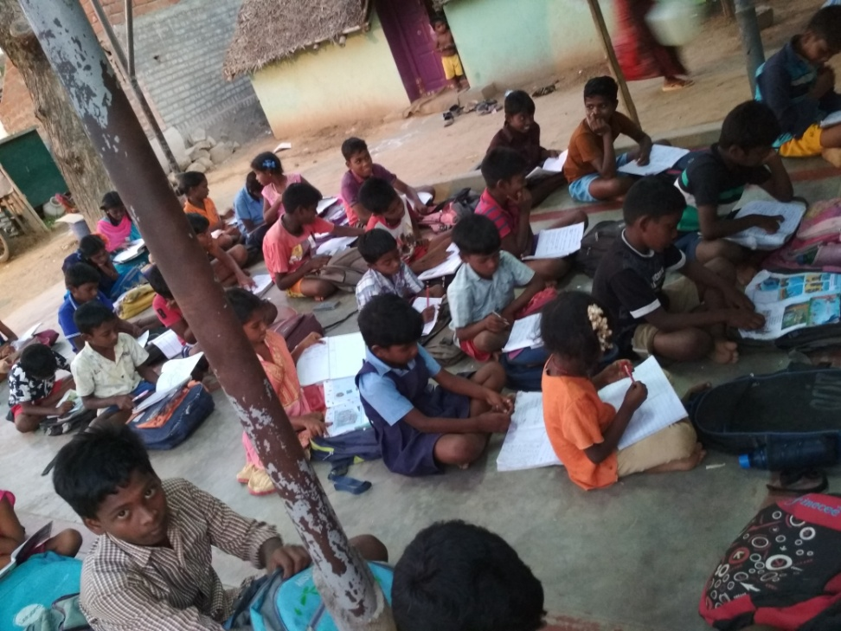
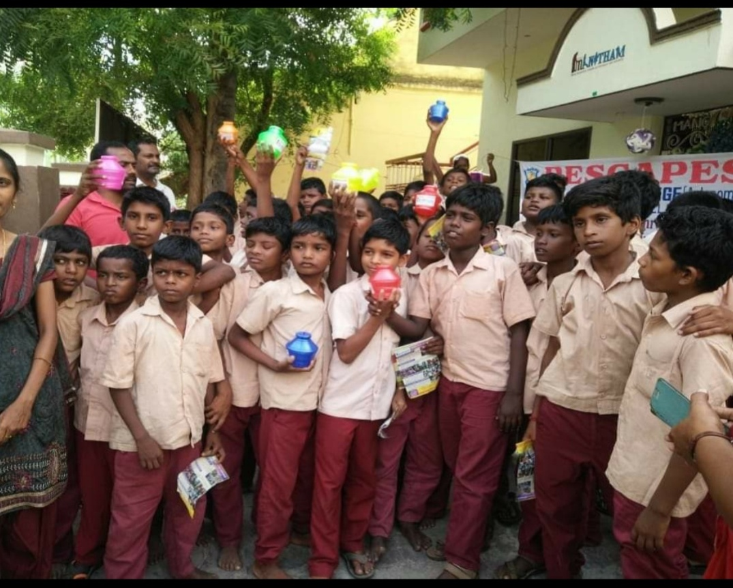
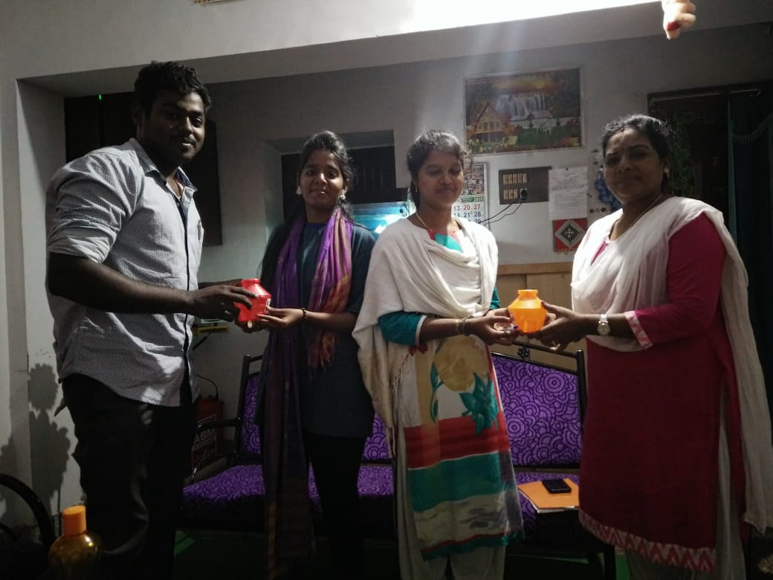

Slide 14
MEETHAM PAGIRVOM :
“If you can’t feed a hundred people, then feed just one.” - Mother Teresa.
AIM :
Our MEETHAM THANTHU MANITHAM KAPOM scheme aims at donating the surplus food and clothes to the homeless and abandoned aged people by their own kith & kin.
EXECUTION :
Under the MEETHAM THANTHU MANITHAM KAPOM scheme our MANITHAM TEAM takes a special effort to collect the surplus and left over food from parties, functions, wedding receptions and distribute it along with the clothes collected from our sponsors and donors to the homeless & abandoned aged people on the streets.

Slide 15
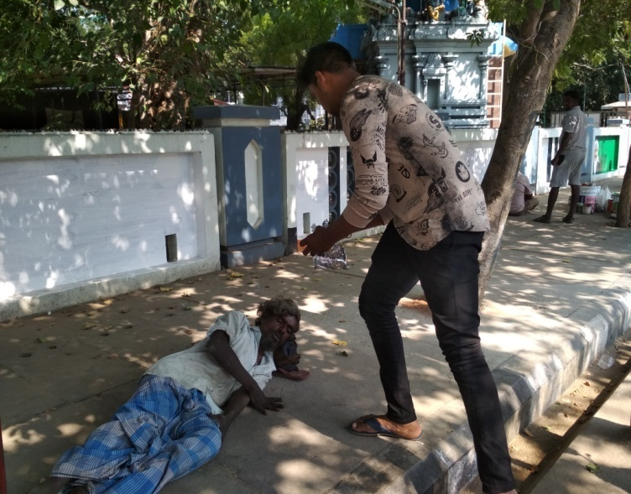
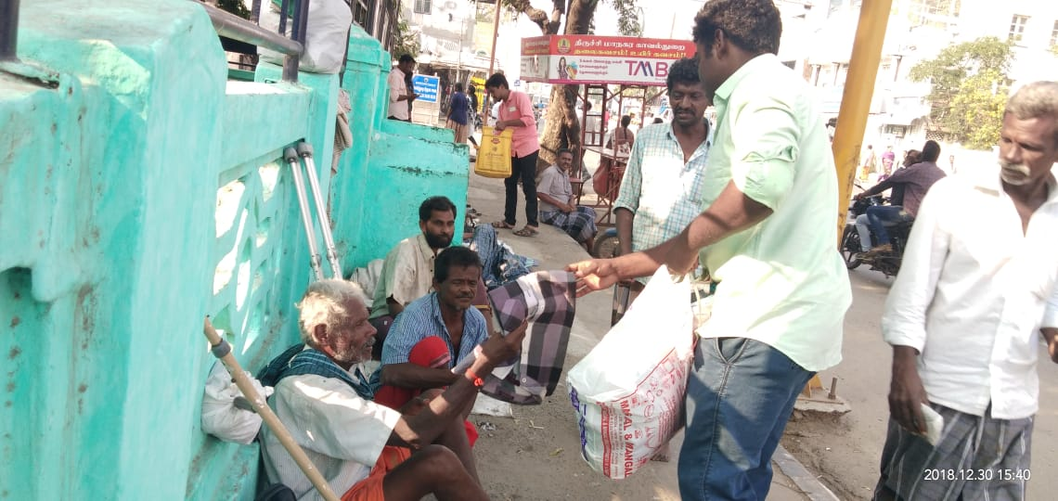
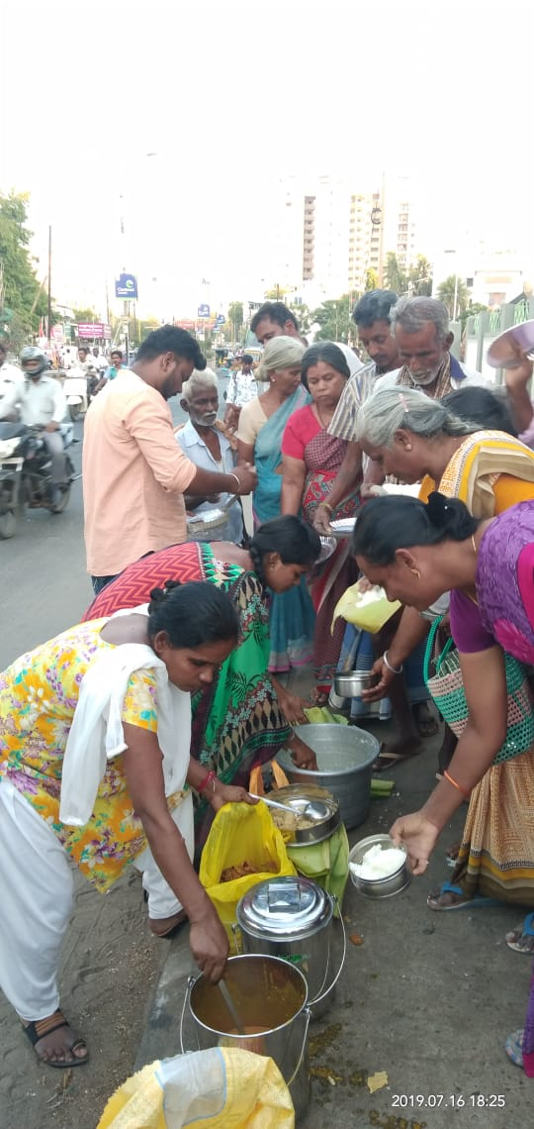
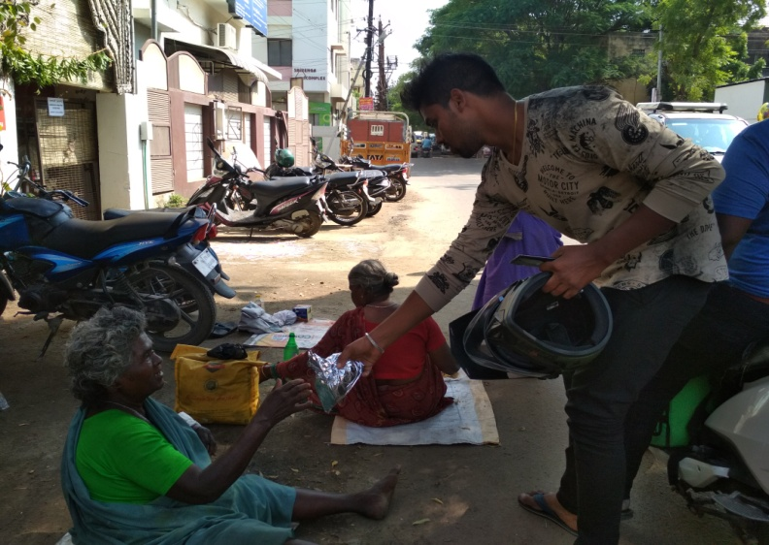

Slide 16
PUTHUMAI PENGAL
“Man treats woman as his own property and not as being capable of feelings, like himself.” - Periyar E.V. Ramasamy
AIMS :
MANITHAM TEAM aims at and focuses on women empowerment & career growth.
EXECUTION :
Tailoring classes are conducted to help women to be self-reliant.
We also provide personal counseling and assistance thereby helping women to lead a stress free life.

Slide 17
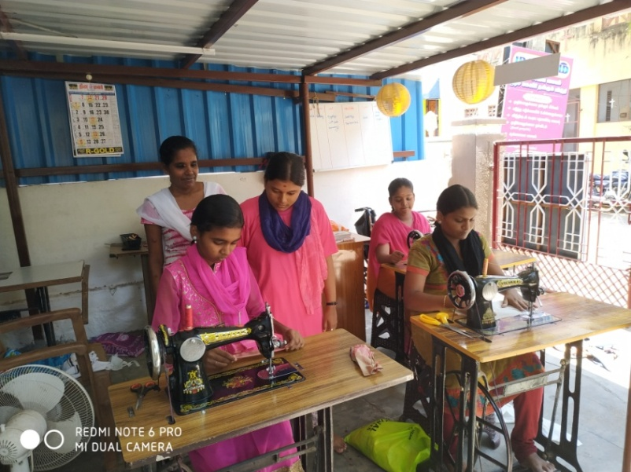
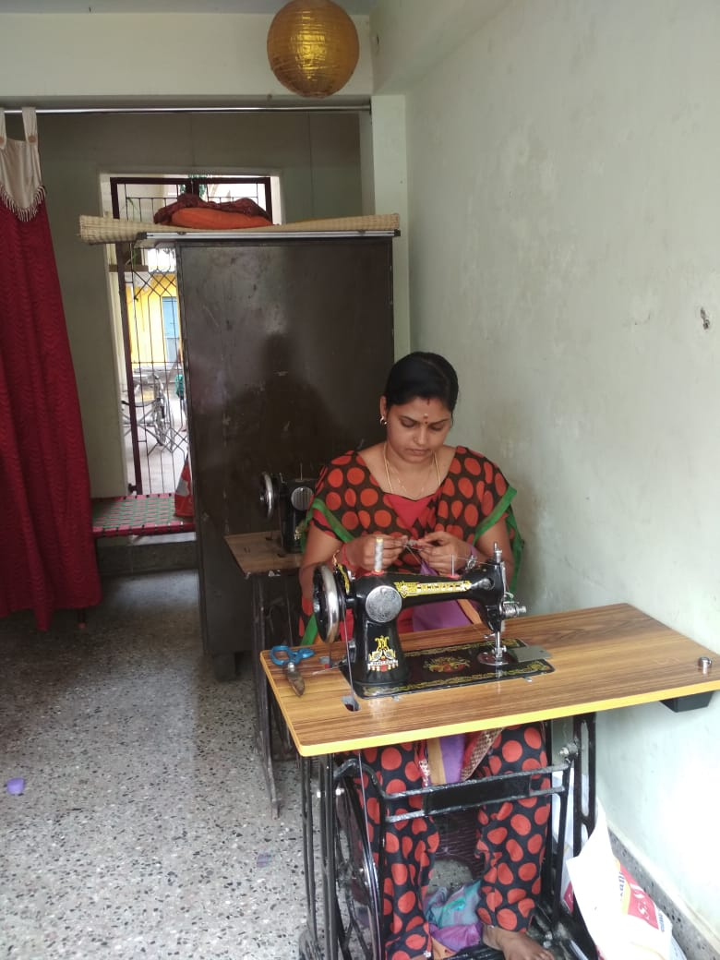

Slide 18
URAVODU INAIPOM
“Never worry about numbers. Help one person at a time, and always start with the person nearest you.” - Mother Teresa
AIM:
The main aim of UNARVAI MATHITHU URAVODU INAIPOM is to rescue the HOMELESS & ABANDONED AGED PEOPLE and reunite them with their family members.
EXECUTION :
Our MANITHAM TEAM goes on rounds searching for the homeless & abandoned aged people residing along the streets .
We interact with them, get to know about their families and their difficulties and we take a special effort and care in grooming them.
We try to trace out their families and reunite them with their families. If the families are not willing to accept them, we take care of them.

Slide 19
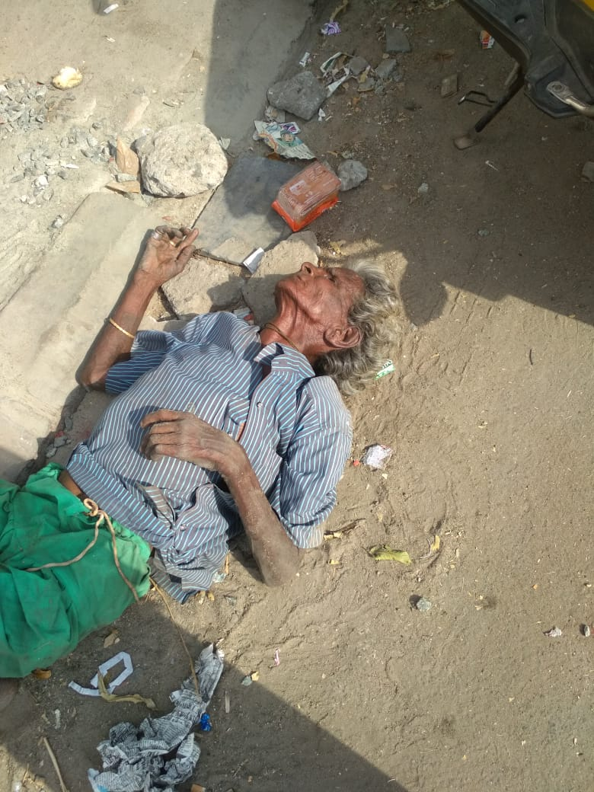
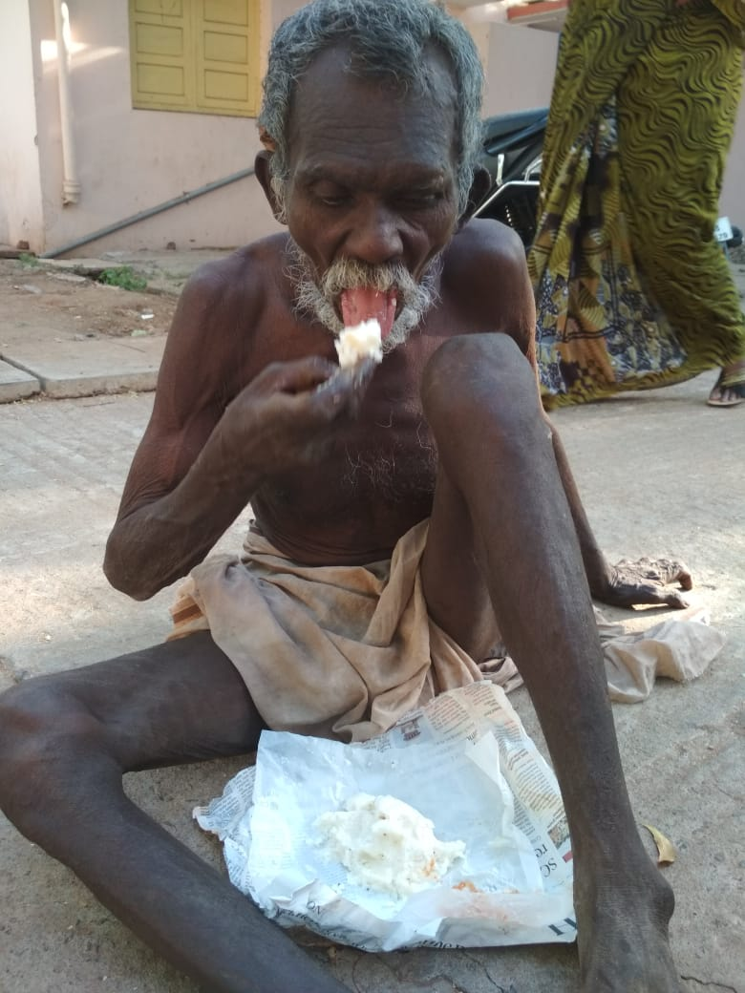
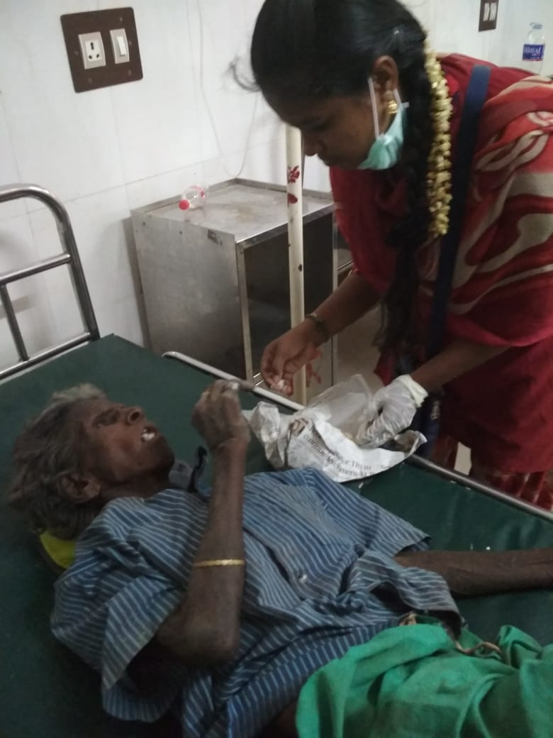
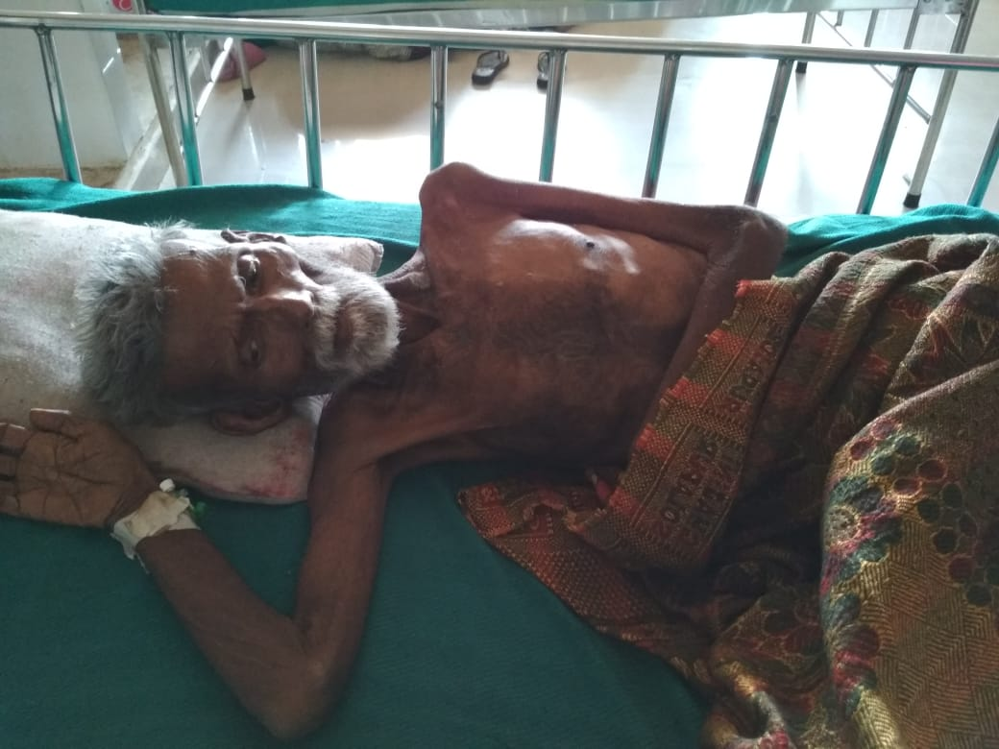

Slide 20
SPECIAL PROGRAMME AND CELEBRATIONS
Birthday celebrations of our sponsors & donors
WOMEN’S DAY CELEBRATION – we search and trace out women peddlers and lend them a helping hand to transform their lifestyle.
Adolescent awareness and stress management programs
Mass rescue program
Awareness campaign to spread the importance of environment & natural resource preservation.
Rescue mission – Natural calamities.

Slide 21
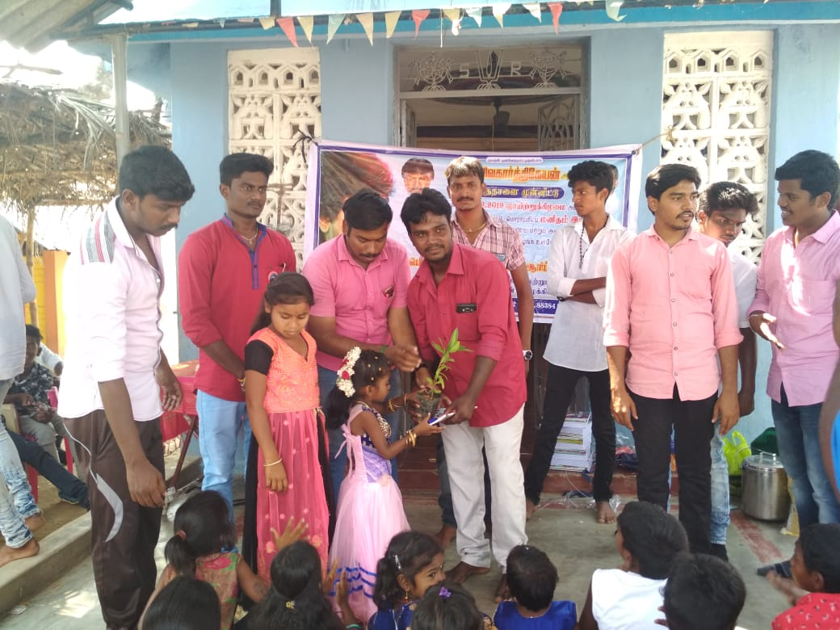
CHILDREN’S DAY PROGRAMME

Slide 22
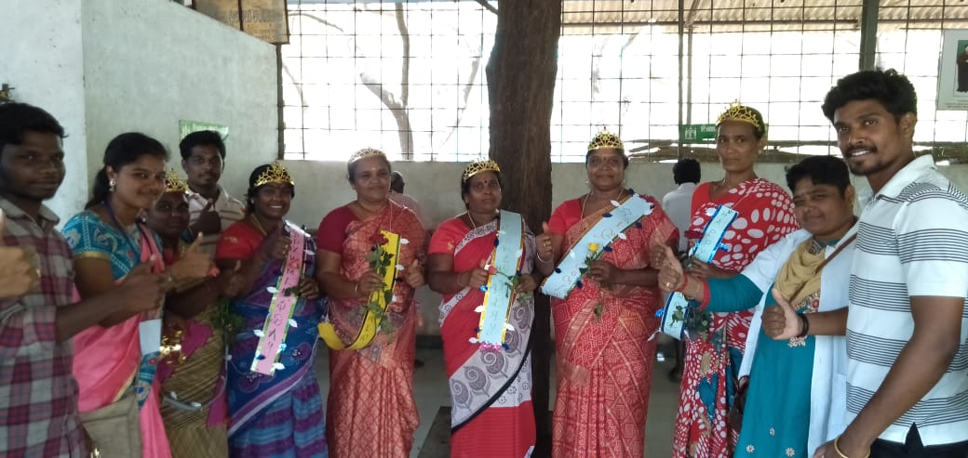
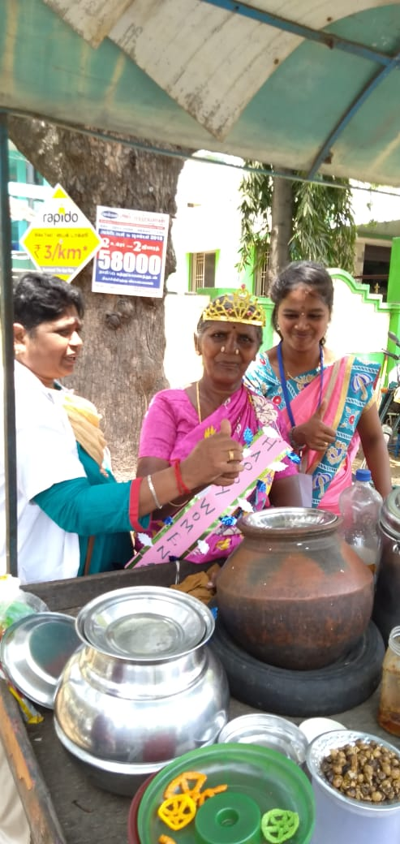
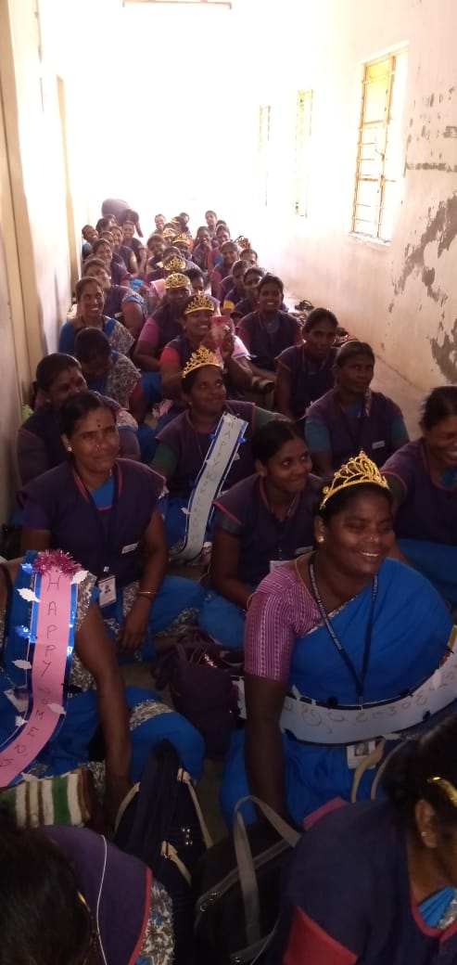
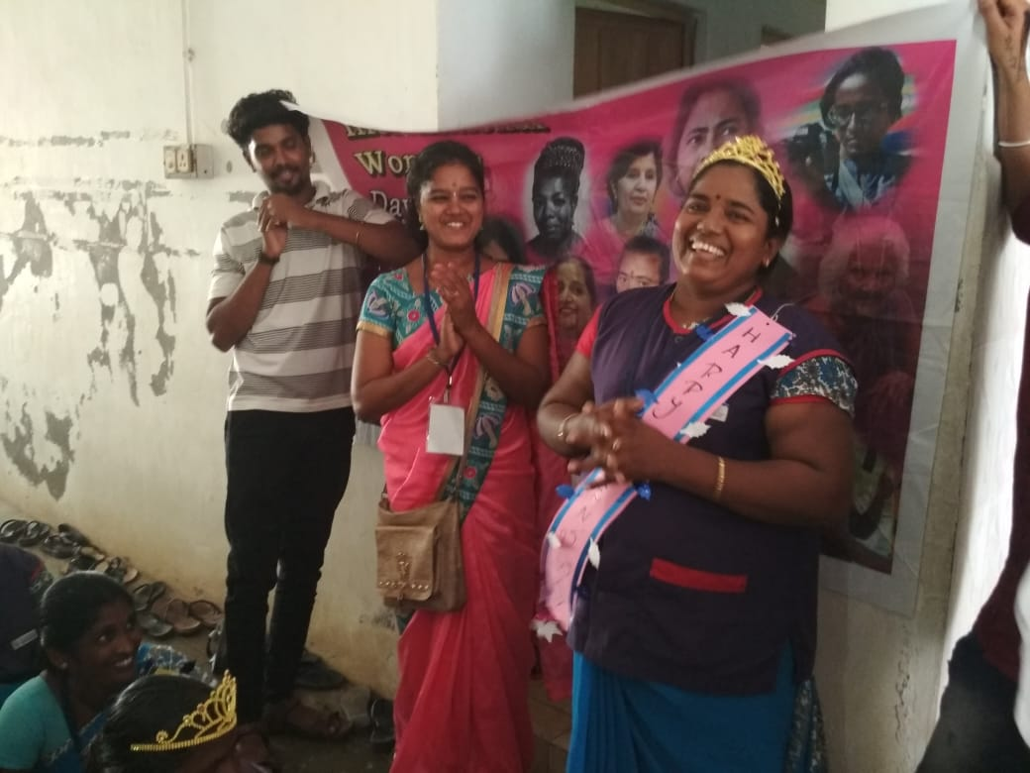
WOMEN’S DAY

Slide 23
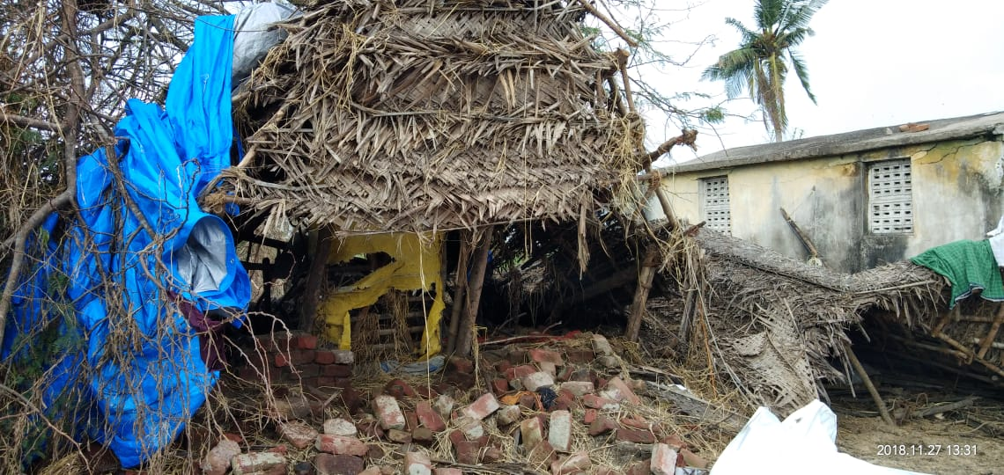
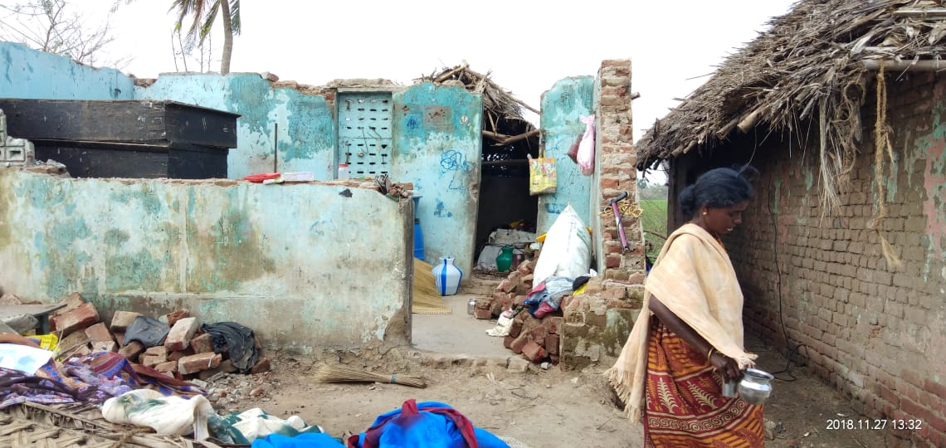
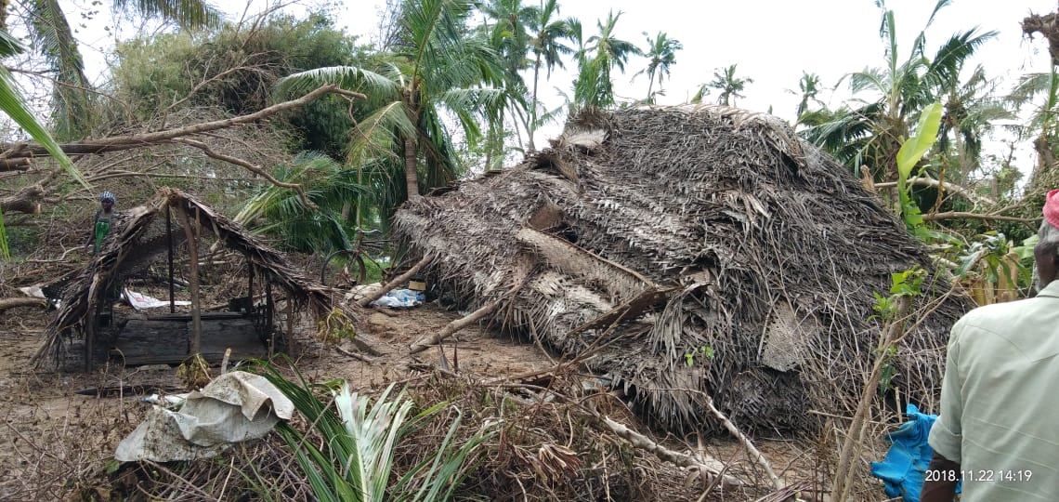
GAJA CYLONE SUPPORT

Slide 24
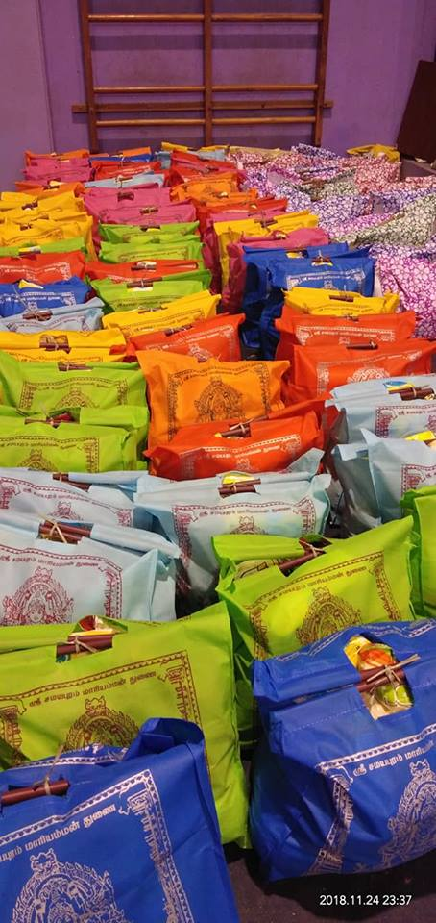
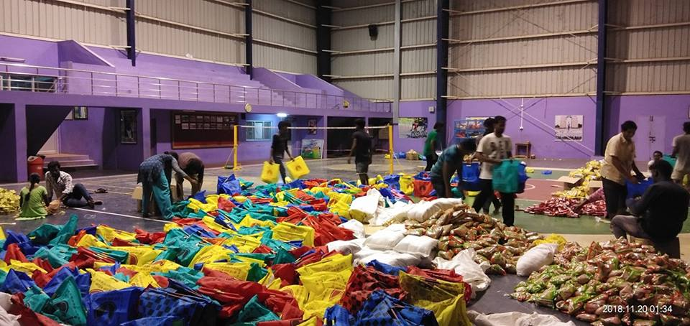
MANITHAM GAJA SUPPORT

Slide 25
SPECIAL PROGRAMMES FOR KIDS :
“It is easier to build strong children than to repair broken men.” – Frederick Douglass.
PROGRAMMES :
ILANTHULIR – camp for children conducted to provide
psychological assistance for the affected kids and also provide life skills training. (150 children participate)
INBAOLI – we celebrate all the festivals including Diwali, Christmas, Ramzan together on a particular day for our kids (150 children participate) and provide them new clothes, crackers, sweets & food.
KATHIROLI – Pongal day celebrations with our adopted community kids (150 children participate)
EDUCATIONAL UTILITIES distribution program – we provide all the necessary amenities required for the education of 150 children.

Slide 26
SPECIAL PROAMMES FOR KIDS (Contd..)
We create Awareness Programs for kids with regards to child abuse, child labor, child sexual abuse
We also give Counseling for the victims of child abuse and child sexual abuse.

Slide 27
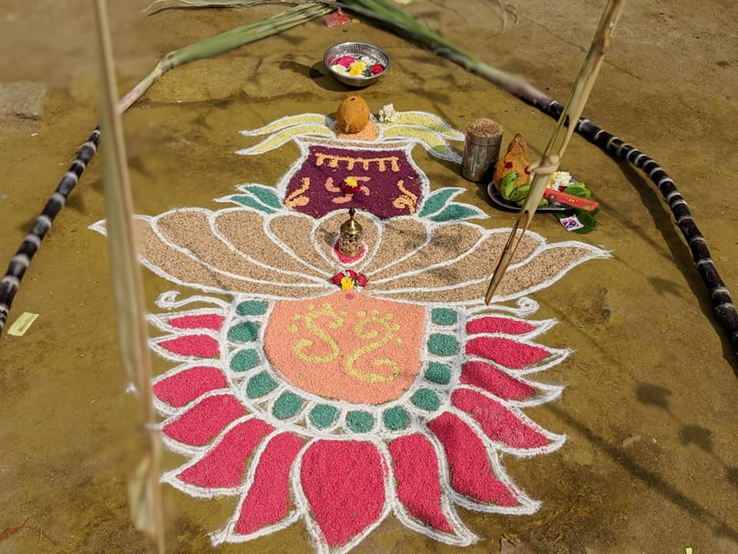
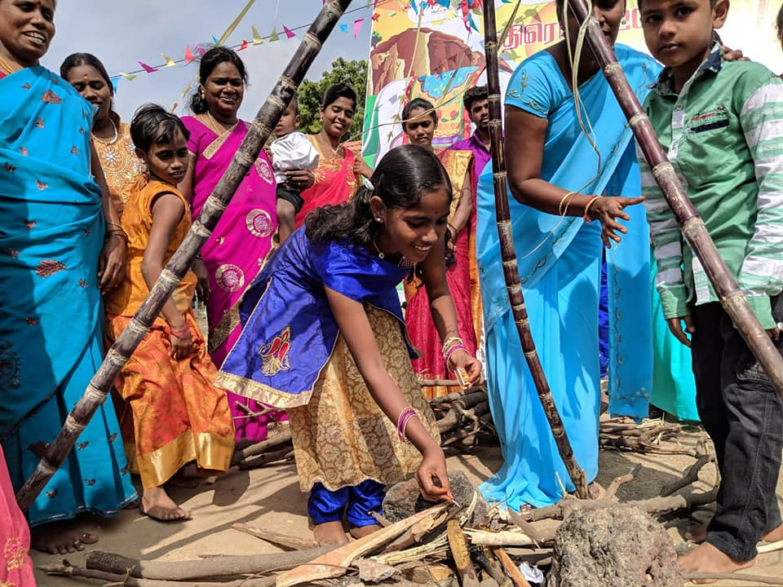
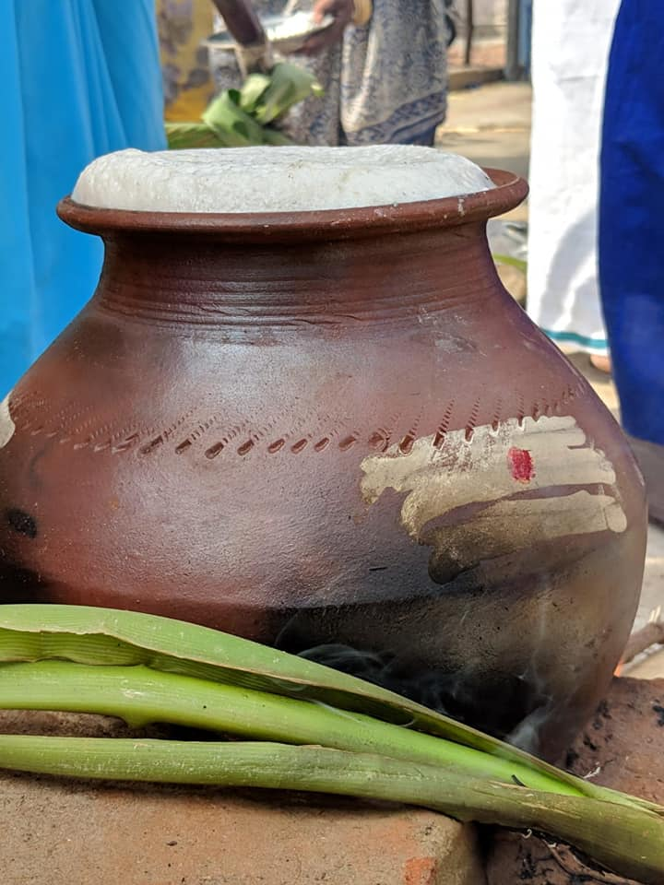
PONGAL CELEBRATION

Slide 28
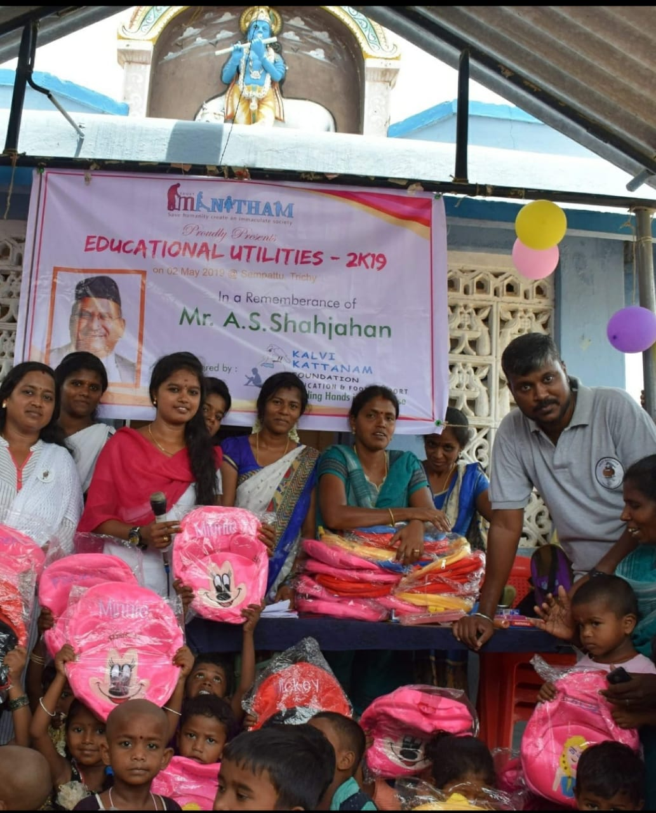

Slide 29
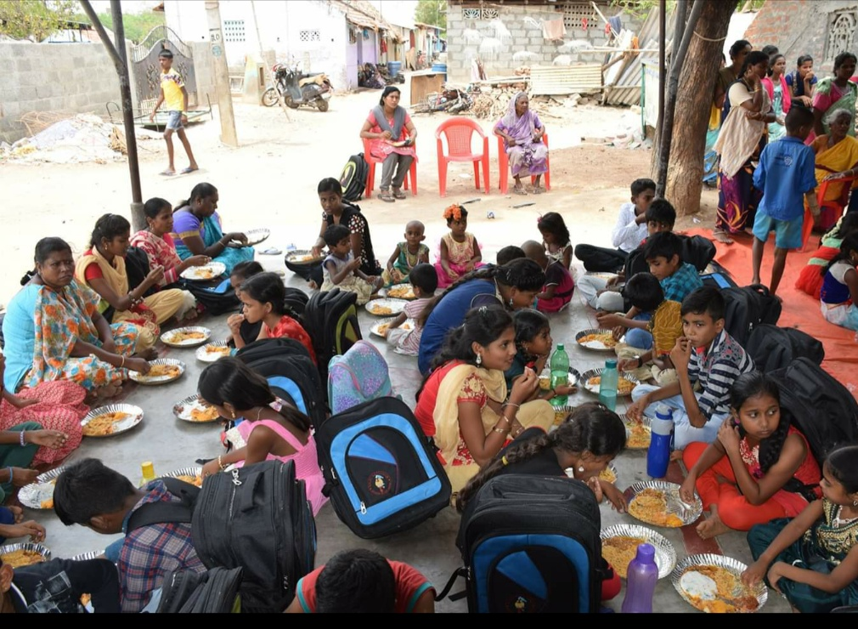

Slide 30
AWARDS & ACCOLADES
We render Honorary awards appreciating the social service rendered by social activists.
We appreciate the services rendered by the public servants and government officials.
We encourage and appreciate the women empowerment and render awards for women striving hard to establish women empowerment.

Slide 31
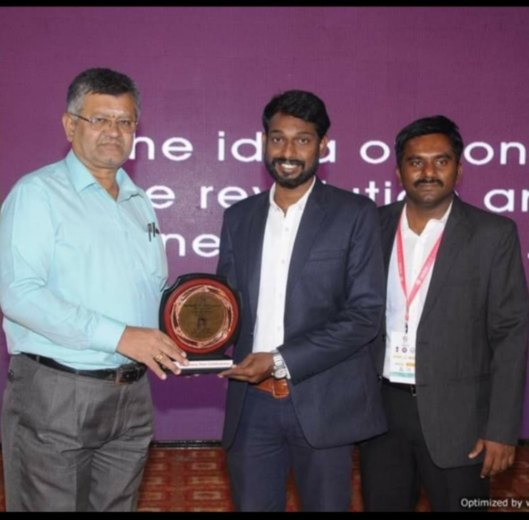
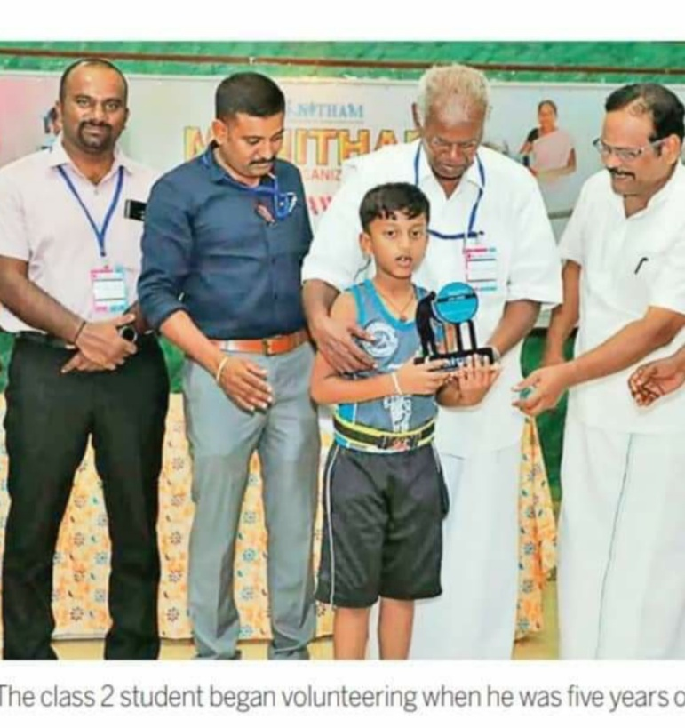
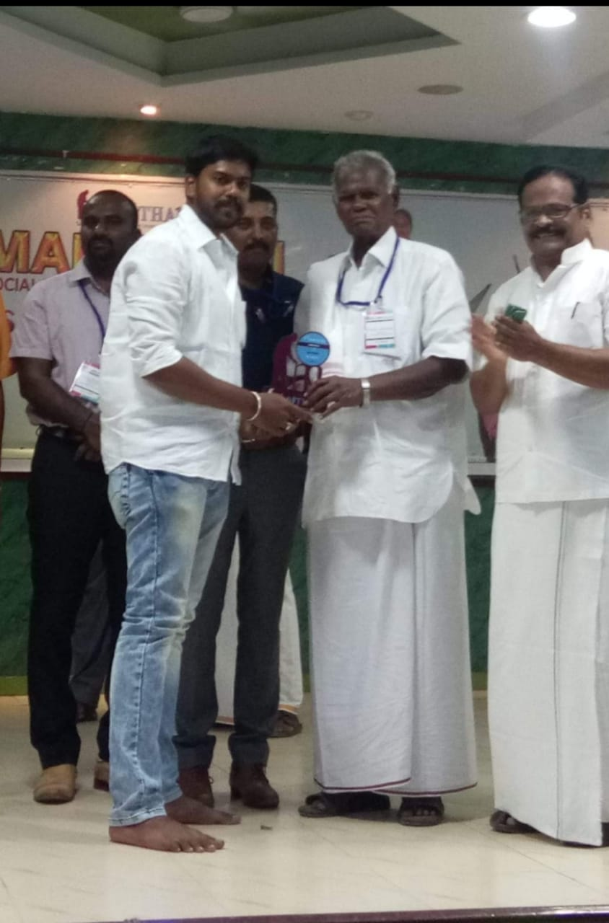

Slide 32
THANK YOU

